Slide 1
Concurrency Control Technique in Distributed Transaction

Slide 2
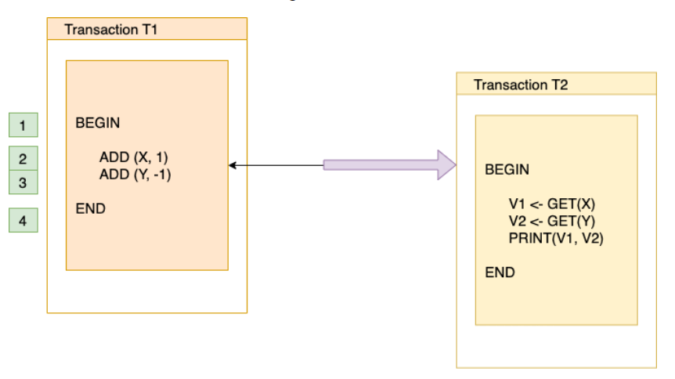
Transaction

Slide 3
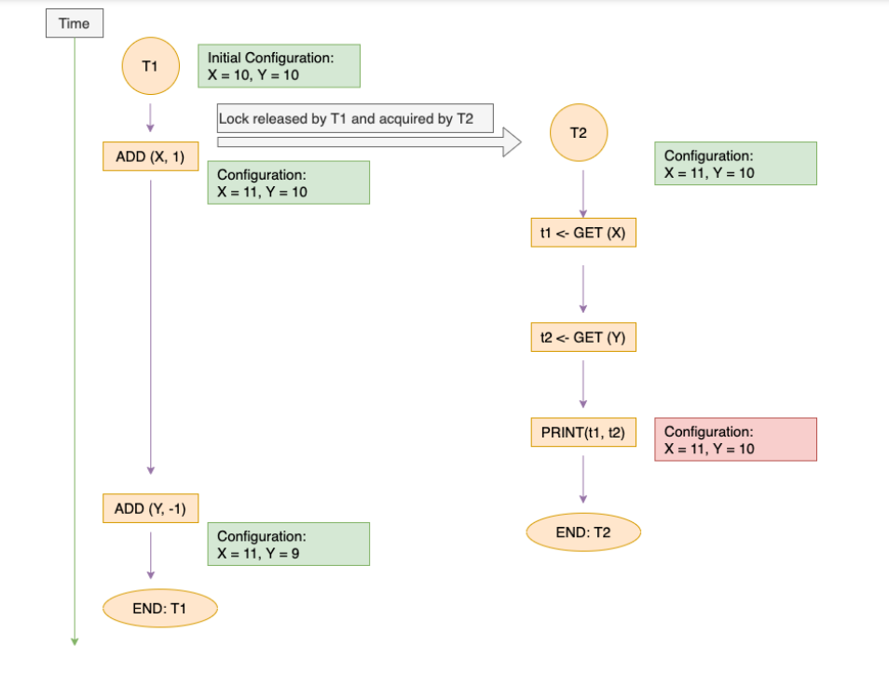
partially complete Transaction

Slide 4
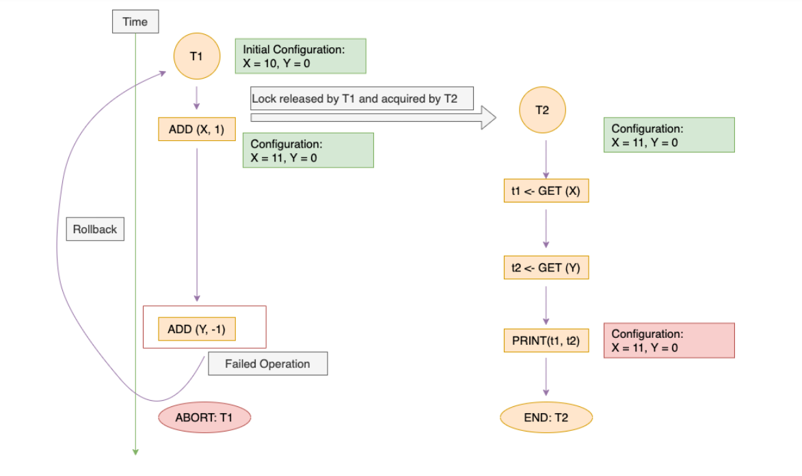
Partially executed transaction got aborted

Slide 5
Concurrency
A situation in which two or more persons access the same record simultaneously is called concurrency.
Concurrency control involve the synchronization of access to the distributed database, such that the integrity of the database is maintained.
Concurrency control is a mechanisms to provide various concepts & implementations to ensure the execution of any transaction across any node doesn’t violate ACID.

Slide 6
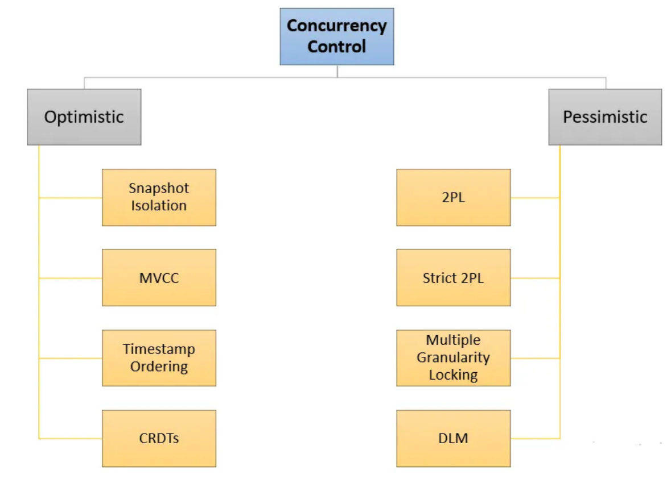
Types of Concurrency Control

Slide 7
Pessimistic Concurrency Control (PCC)
Pessimistic Concurrency Control Mechanisms proceeds on assumption that, most of the transactions will try to access the same resource simultaneously.
It’s basically used to prevent concurrent access to a shared resource and provide a system of acquiring a Lock on the data item before performing any operation.
The four Pessimistic Concurrency Control Methods:
Isolation Level: The isolation levels are defined as a degree to which the data residing in Database must be isolated by transactions for modification.
Methods provided in this are: Read-Uncomitted, Read-Comitted, Repeatable Read & Serializable.
Two-Phase Locking Protocol: The two-phase locking protocol is a concurrency technique used to manage locks on data items in database. This technique consists of 2 phases:
Growing Phase: The transaction acquires all the locks on the data items that’ll be required to execute the transaction successfully. No locks will be realease in this phase.
Shrinking Phase: All the locks acquired in previous phase will be released one by one and No New locks will be acquired in this phase.
Distributed Lock Manager: It co-ordinates the lock acquiring, and releasing operations in the transactions. It helps in synchronizing the transaction and their operation so that data integrity is maintained.
Multiple Granularity Lock: A lock can be acquired at various granular level like: table level, row/record level, page level or any other resource’s level.
Transaction system a transaction can lock a whole table, or a specific row while performing some changes on it.

Slide 8
Optimistic Concurrency Control (OCC)
The problem with pessimistic concurrency control systems is that, if a transaction acquires a lock on a resource so that no other transactions can access it.
This will result in reducing concurrency of the overall system.
Optimisitc Concurrency control techniquesproceeds on the basis of assumption that, 0 or very less transactions will try to access a certain resource simultaneously.
It has following 4-phases of operation:
Read Phase
Execute Phase
Validate Phase
Commit Phase

Slide 9
Snapshot Isolation
Snapshot Isolation ensures that each transaction sees a consistent snapshot of the database at the start of the transaction.
MVCC and timestamp ordering method help us achieve snapshot isolation.

Slide 10
MVCC (Multi-Version Concurrency Control)
MVCC maintains multiple versions of data and allows transactions to proceed without acquiring locks upfront.
Example: In a banking system, multiple users can concurrently transfer funds between accounts without blocking each other.
Each transaction operates on its own version of the account balances, ensuring consistency upon commit.

Slide 11
Timestamp Ordering
Timestamp Ordering assigns unique timestamps to transactions and enforces a total order of their execution.
Example:
In a distributed system, transactions for processing customer orders are assigned timestamps. The system ensures that the order processing follows the order of timestamps to prevent conflicts and maintain consistency.

Slide 12
CRDT (Conflict-Free Replicated Data Type)
CRDT is a distributed data structure that enables concurrent updates in a distributed system without the need for centralized coordination or consensus algorithms.
CRDTs are designed to handle conflicts that may arise when multiple users concurrently modify the same piece of data.
One common use case for CRDTs is collaborative real-time editing applications, where multiple users can simultaneously edit a shared document.

Slide 13
Two-Phase Locking (2PL)
2PL acquires locks on data resources upfront and releases them at the end of the transaction.
Example:
In a shared database, when a user wants to update a specific row of data, 2PL ensures that other users cannot access or modify the same row until the lock is released, preventing conflicts.

Slide 14
Strict Two-Phase Locking (Strict 2PL)
Strict 2PL variant of 2PL where all locks acquired during a transaction are held until the transaction is committed or rolled back. Example:
In a distributed database, a transaction locks all the necessary resources (e.g., tables, rows) at the beginning and holds the locks until the transaction is completed, ensuring no other transactions can access or modify the locked resources.

Slide 15
Multiple Granularity Locking
Multiple Granularity Locking allows acquiring locks at various levels of granularity, such as table level, page level, or row level.
Example:
In a database system, a transaction can acquire a lock at the row level for a specific record it wants to update, preventing other transactions from modifying the same record but allowing concurrent access to other records in the table.

Slide 16
OCC and PCC depends on factors such as workload characteristics, contention level, and desired level of concurrency and performance.

